Slide 1

Year 4 Multiplication Tables Check (MTC) 2026

Slide 2
What is the MTC?
The MTC (Multiplication Tables Check) is a short online test for Year 4 pupils in England.
It checks how well children know their multiplication tables up to 12 × 12.
The check is statutory for all Year 4 pupils (required by the government).

Slide 3

The purpose
The MTC determines if Year 4 children can fluently recall their multiplication tables.
It is designed to help schools identify which children require more support in learning their times tables.
There is no ‘pass’ rate or threshold which means that children will not be expected to re-sit the check. The average score is 22. Ideally we will be aiming for 25

Slide 4
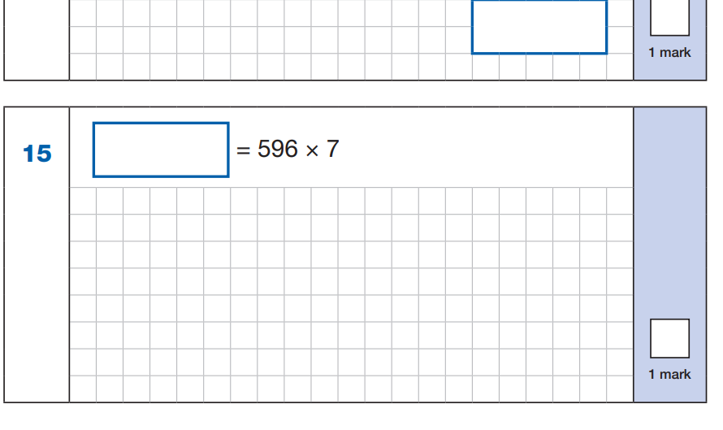
Impact through the school
Although they will not have to retake this, times tables are essential in other areas of Maths. At the moment we are learning about fractions, this becomes so much easier when children know the times tables.
In Year 6, when they sit their SATS, the arithmetic paper relies on quick recall of multiplication to help solve larger questions.
If children know,
5 x 7
9 x 7
6 x 7
Then they can work out,
500 x 7
90 x 7
6 x 7
These test papers in Year 6 are timed.

Slide 5
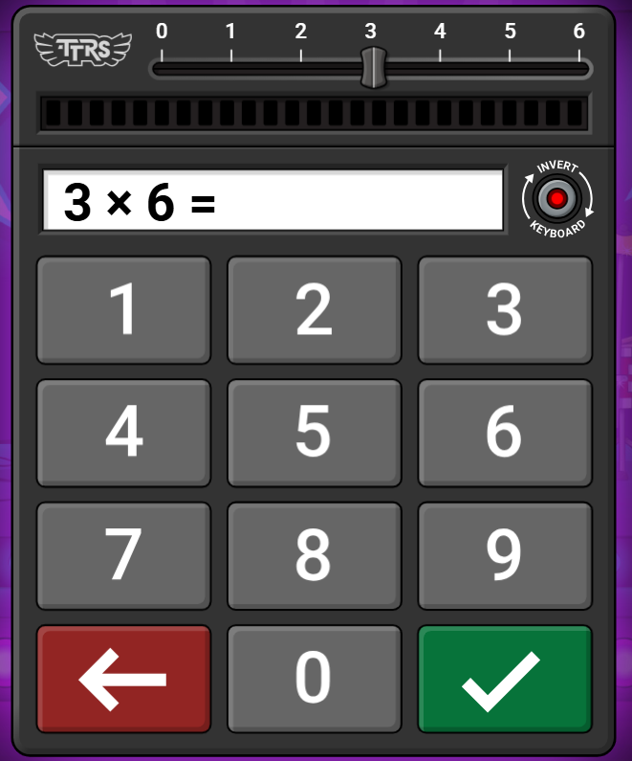
How the check is carried out
The check will be fully digital and answers will be entered through an on-screen number pad.
The children will have 6 seconds from the time the question appears to input their answer.
There will be a total of 25 questions.
There will be an opportunity for you to look and have a go at a test example today on TTRS. Children are used to how the test works now.

Slide 6
The check questions
Each child will be randomly assigned a set of questions. There will only be multiplication questions in the check, not division facts.
The 6, 7, 8, 9 and 12 times tables are more than likely to be asked.
Reversal of questions (e.g. 8 x 6 and 6 x 8) will not be asked in the same check.
Children will not see their individual results when they complete the check, we will share the results with you once received.

Slide 7
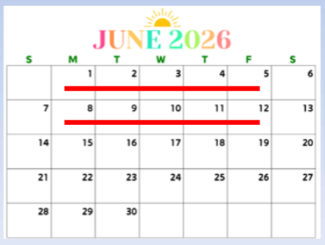
When will the check take place?
There will be a 2-week window in June 2026 for schools to administer the check (1st June – 12th June).
There is no set day to administer the check.
An additional week is available for schools to catch up on any absences or technical delays.

Slide 8
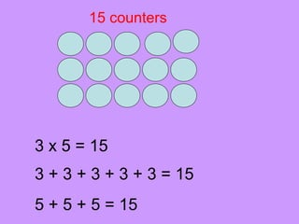
Some of the things we have been doing in class to support with times tables knowledge
Counting and looking for patterns.
Understanding that multiplication is repeated addition.
Remember that multiplication is commutative.
Recall and utilise fact families.
Create pictorial representations such as arrays.
Use of TTRS / quick fire games

Slide 9
How to best prepare your child for the check
Remind them that the check should last no more than 5 minutes.
We are going to give you the opportunity to explore some fun times tables activities you can have a go at home.
If you have any concerns, talk to your child’s teacher.
There are lots of good websites with free resources.
Home Learning - Third Space Learning Blog

Slide 10

Activities around the hall
Ipads – have a go at a MTC on TTRS
Flashcards – quickfire
Multiplication wheels
Counting in multiples / arrays – concrete resources
Board games

